Slide 1
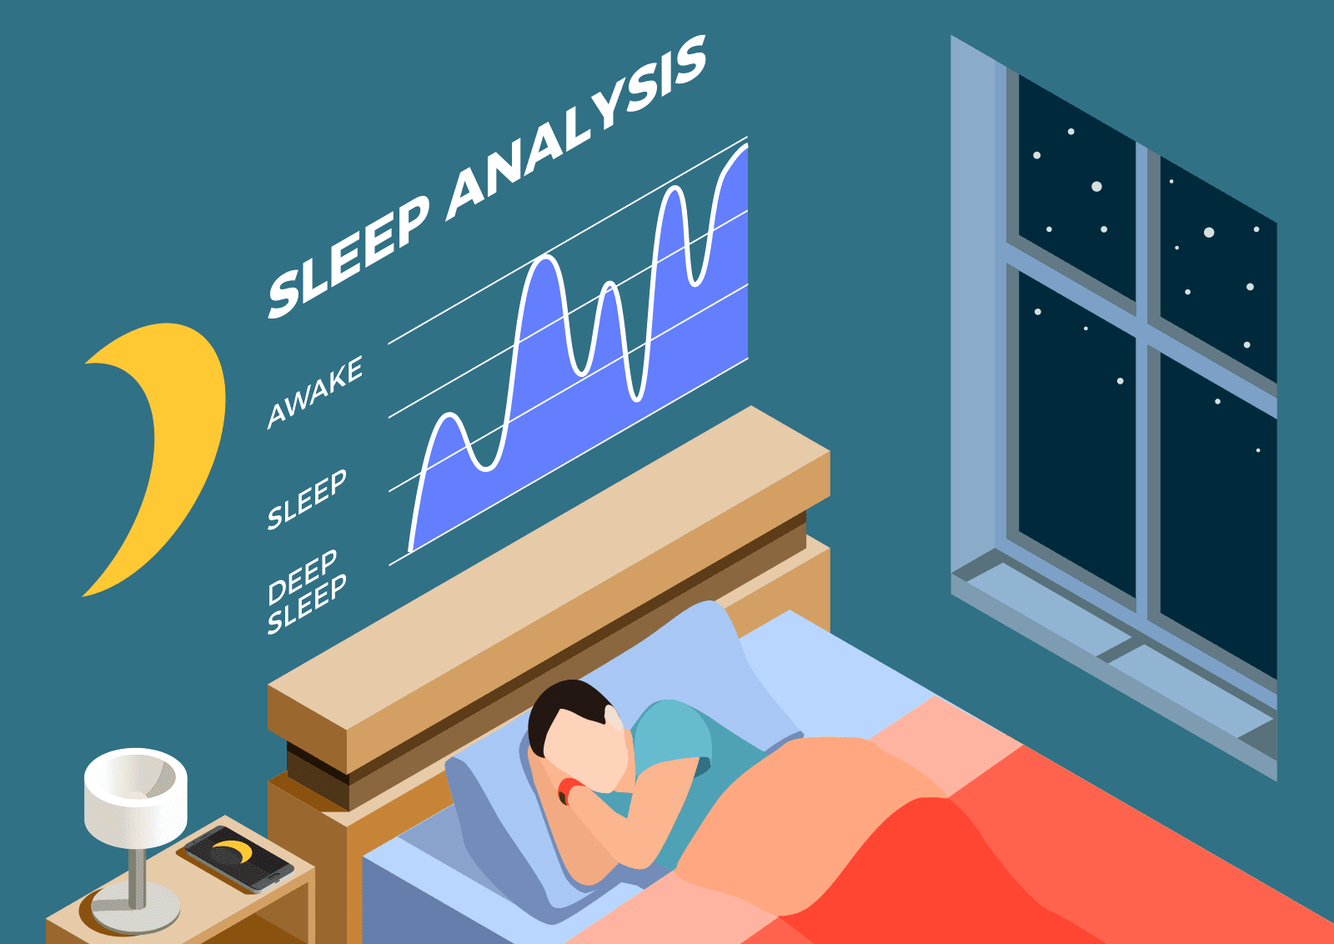
EDA MINI PROJECT
Sleep Efficiency
Group 1 Presentation

Slide 2
Content
Project Objective
Group Information
Introduction of Dataset
Findings
Challenges and Limitations
Conclusion
Reference

Slide 3
Project Objective
Sleep pattern (time to sleep and wake up)
Analyse relationship and influence on sleep efficiency & quality
regarding Age, Smoking, REM Sleep 快速動眼, Light Sleep 淺睡, Deep Sleep 深睡, Exercise, Alcohol 酒精, Caffeine consumption 咖啡因攝取量, Awakenings 覺醒

Slide 4
Group Information
Group Name: Group 1
Group Member:
Lai Chui Ting, Paris
Shih Ting Ting, Tammy

Slide 5
Introduction of Dataset
We will adopt data according to:
Age
Gender
Bedtime
Wakeup time
Sleep duration
Sleep efficiency: % of actual sleep time over the amount of time spends in bed.
REM sleep%/ Deep sleep%/Light sleep% (% of total sleep time spent in REM/deep/light sleep)
Awakenings: number of time wake up during the night
Caffeine consumption
Alcohol consumption
Smoking status
Exercise frequency
Age | Gender | Bedtime | Wakeup time | Sleep duration | Sleep efficiency | REM sleep % | Deep sleep % | Light sleep % | Awakenings | Caffeine consumption | Alcohol consumption | Smoking status | Exercise frequency
65 | Female | 2021-03-06 01:00:00 | 2021-03-06 07:00:00 | 6.0 | 0.88 | 18 | 70 | 10 | 0.0 | 0.0 | 0.0 | Yes | 3.0
69 | Male | 2021-12-05 02:00:00 | 2021-12-05 09:00:00 | 7.0 | 0.66 | 24 | 28 | 53 | 3.0 | 0.0 | 3.0 | Yes | 3.0
40 | Female | 2021-05-25 21:30:00 | 2021-05-25 05:30:00 | 8.0 | 0.89 | 20 | 70 | 10 | 1.0 | 0.0 | 0.0 | No | 3.0

Slide 6
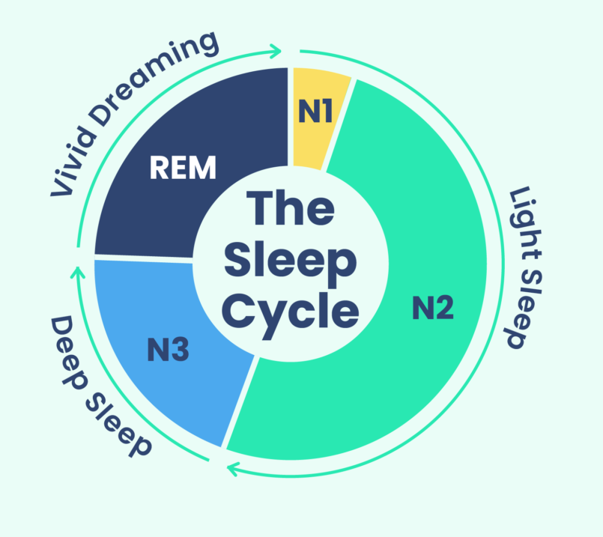
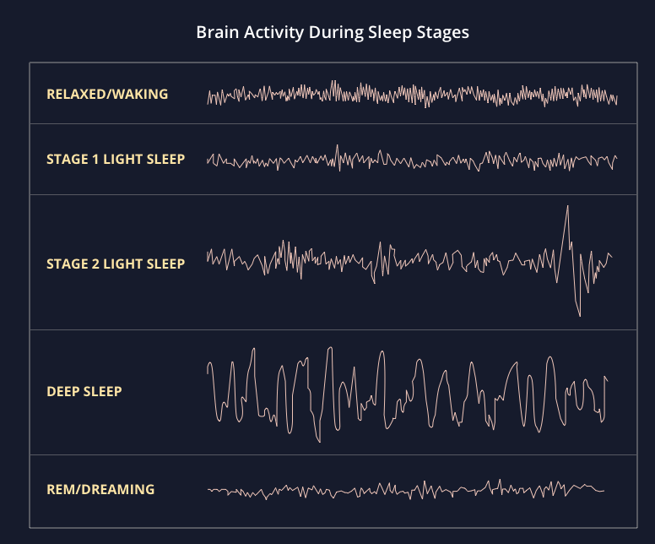
Introduction of Dataset
What Is REM Sleep 快速動眼? (Stage 1)
Happens 90 minutes after you fall asleep
The first period of REM typically lasts 10 minutes
What is Light Sleep 淺睡? (Stage 2)
The beginning of the sleep cycle
Spend about half of your total sleep time in light sleep
What is deep sleep 深睡? (Stage 3)
Helps the brain rest and recover
Contributes to keeping hormones balanced

Slide 7
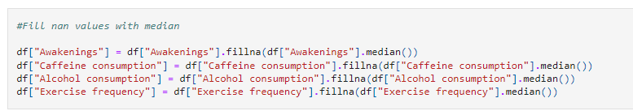
Findings
Overall Data Review:
Handling for missing values:
Number of Variables | 15
Number of Rows | 452
Missing Cells | 65
Missing Cells (%) | 1.0%
Duplicate Rows | 0
Variable Types | Numerical: 6 Categorical: 9
Item | Missing Values | Handling
Awakenings | 20 (4.42%) | Replaced by median
Caffeine consumption | 25 (5.53%) | Replaced by median
Alcohol consumption | 14 (3.1%) | Replaced by median
Exercise frequency | 6 (1.33%) | Replaced by median

Slide 8
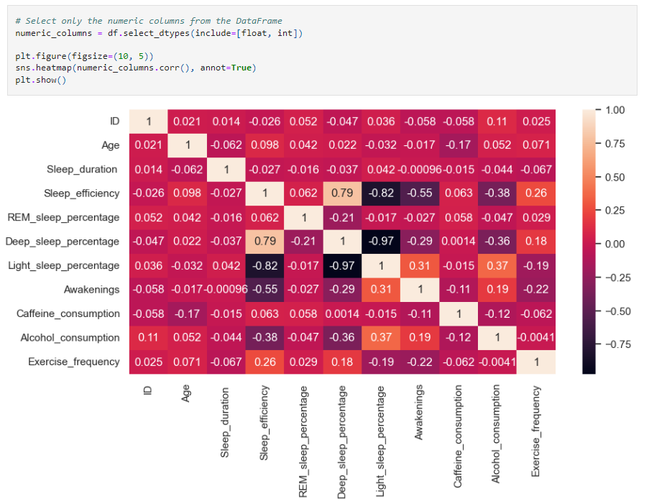
Findings
Bivariate Analysis
Result: Deep sleep % has significant influence on sleep efficiency

Slide 9
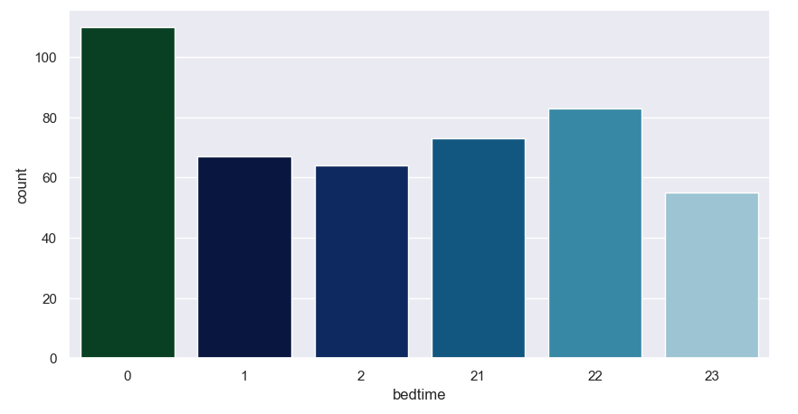
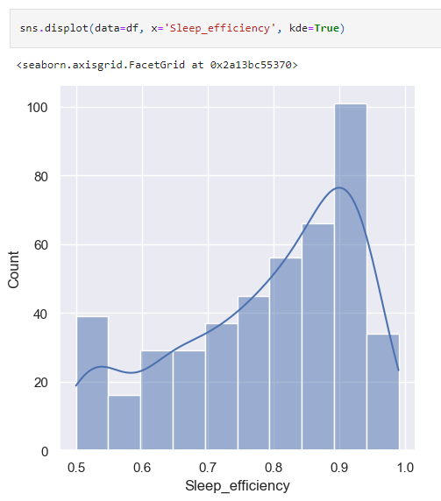
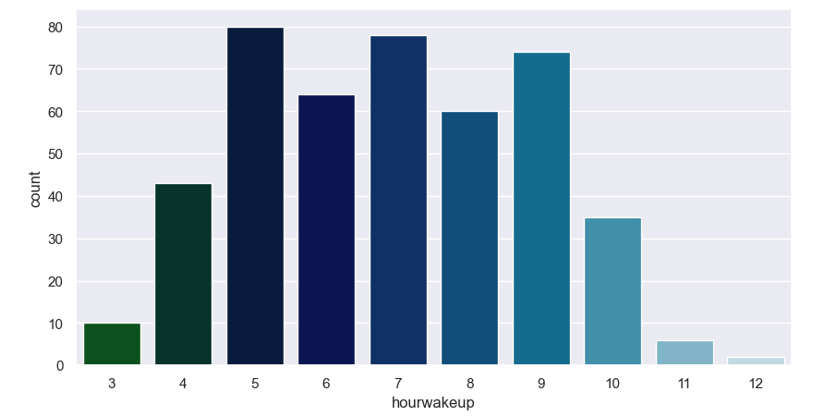
Findings
Most people sleep at 0am.
Most people has 0.9 sleep efficiency
→high sleep efficiency
Most people wake up at 5am and 7am

Slide 10
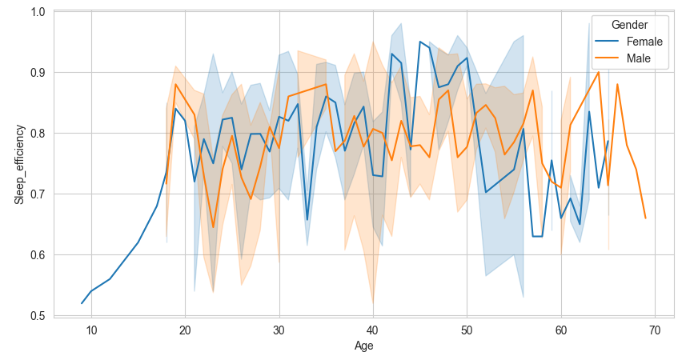

Findings
Is there a relationship between age and sleep efficiency?
Result: Yes, have significant different between male and female
 | Lowest Sleep Efficiency | Highest Sleep Efficiency
Male (Age) | 20-30 | 60-65
Female (Age) | 55-65 | 40-50

Slide 11
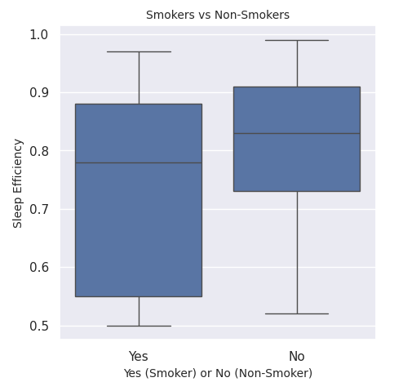
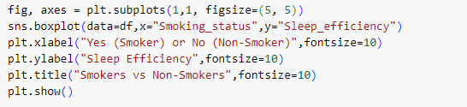
Findings
Does smoking affect sleep patterns?
Result: Non-smokers have better sleep efficiency

Slide 12
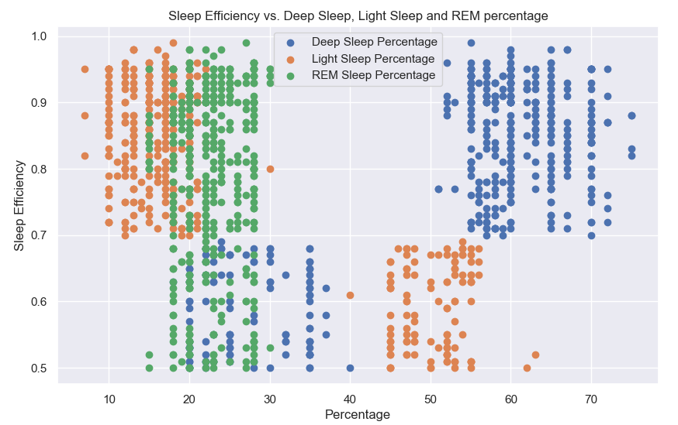
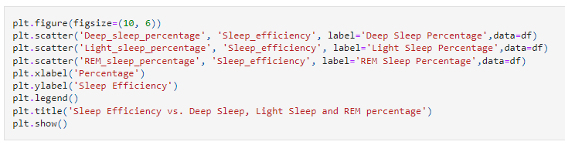
Findings
Is there a relationship between Deep sleep %, Light sleep %, REM sleep %, and Sleep efficiency?
More Deep sleep % will have higher sleep efficiency. (Positive)
More Light sleep % will have lower sleep efficiency.(Negative)
Most people has 20-30% REM sleep. REM sleep does not affect on sleep efficiency.(No effect)
More than 50% of deep sleep provides 70-95% sleep efficiency.
Below 25% of light sleep provides 70% - 95% sleep efficiency.

Slide 13

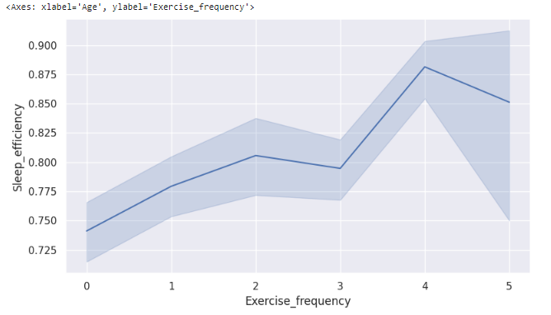
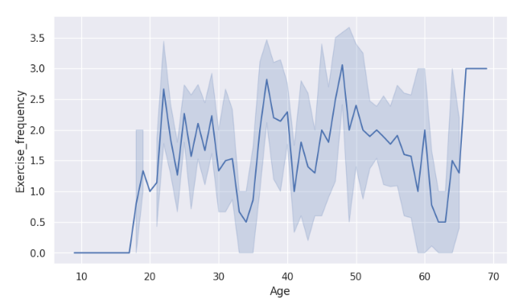
Findings
Does exercise affect sleep efficiency?
Result: do more exercise, get better sleep efficiency

Slide 14
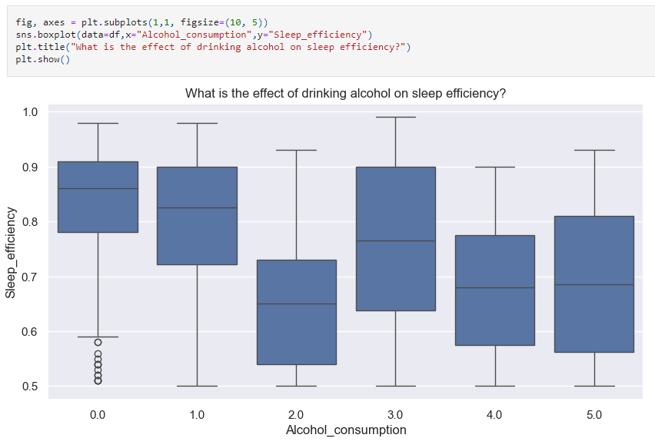

Findings
What is the effect of drinking alcohol on sleep efficiency?
Result: sleep efficiency is lower once alcohol consumption is higher

Slide 15
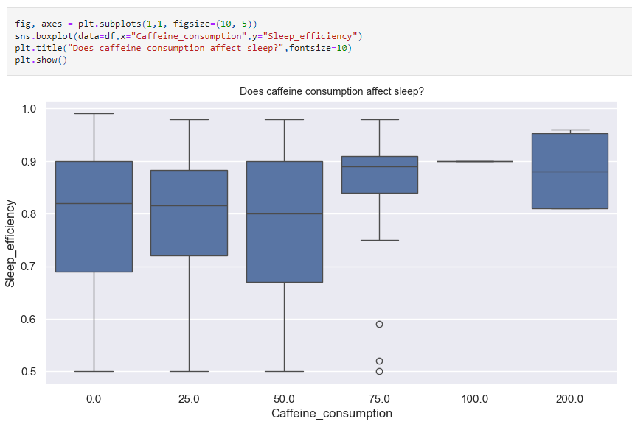

Findings
Does caffeine consumption affect sleep efficiency?
Result: Taking caffeine has no effect on sleep efficiency

Slide 16
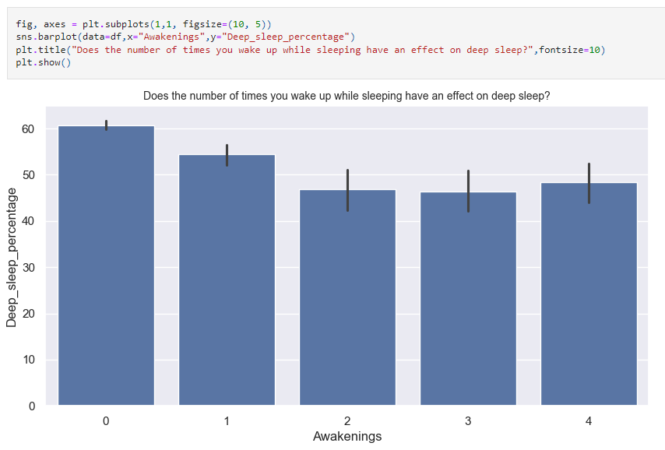
Findings
Does the number of times you wake up while sleeping have an effect on deep sleep?
Result: The quality of sleep decreases with each waking up

Slide 17
Challenges and Limitations
Challenges:
Handling missing value: need to use appropriate technique (fill or remove row)
Difficult in choosing suitable chart for visualization
Difficult to analyze in deep
Limitations:
Small data pool on dataset (~500 rows), low representative
Age distribution is uneven, most of age groups are adults.

Slide 18
Conclusion
Overall:
7.5 hours sleep
Go to bed at 0am and wake up at 5am & 7am.
The quality of sleep decreases with each waking up
Give higher Sleep efficiency:
More Deep sleep %
Do more exercise
Less alcohol consumption
Less smoking

Slide 19
Reference
https://www.kaggle.com/datasets/equilibriumm/sleep-efficiency
https://www.sleepfoundation.org/stages-of-sleep
https://www.verywellhealth.com/the-four-stages-of-sleep-2795920
https://sleepspace.com/sleep-cycles/

Slide 20
Thank You!

